Slide 1

Machine Learning
Session 1

Slide 2




Session 1
Topics
Introduction to Machine Learning.
History of Machine Learning.
Why ML.
Applications of ML.
Algorithms on ML.
------BREAK-----
Python tutorial
Model representation, Hypothesis function, Cost Function(Mean square Error).
Grow Through

Slide 3
Session 1
Intro to ML
the study of computer algorithms that improve automatically through experience.
Machine Learning is a subset of artificial intelligence.
Machine learning algorithms build a mathematical model based on sample data(training data), in order to make predictions or decisions without being explicitly programmed to do so.
Machine learning is closely related to computational statistics.
The study of mathematical optimization delivers methods, theory and application domains to the field of machine learning.
Grow Through

Slide 4
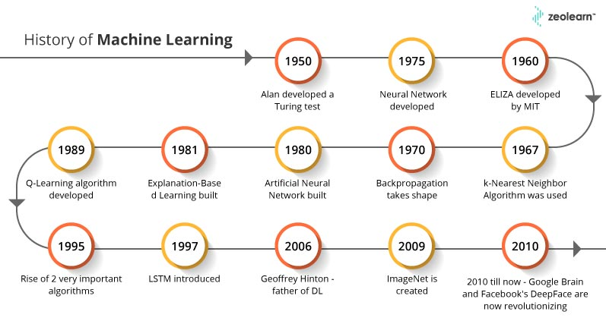
Session 1
History of ML
Grow Through

Slide 5
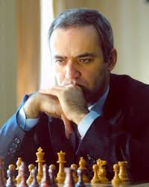
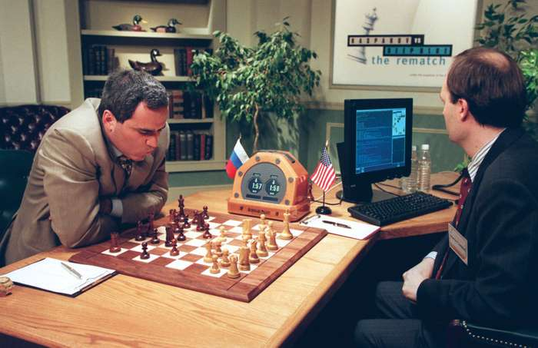
Session 1
History of ML
The struggle between computer of IBM and Garry Kasparov(the youngest world champion in chess) in 1997 and the computer could beat Kasparov after 5 times of lose and studying more than (7000000) game of chess .
Grow Through

Slide 6
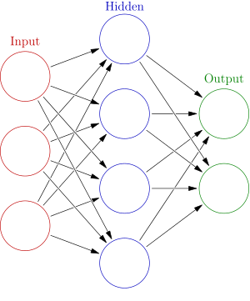
Session 1
Artificial neural networks
Computing systems vaguely inspired by the biological neural networks that constitute animal brains.
The original goal of the ANN approach was to solve problems in the same way that a human brain would.
Used on a variety of tasks(computer vision, speech recognition, machine translation, social network filtering, playing board and video games and medical diagnosis).
Grow Through

Slide 7
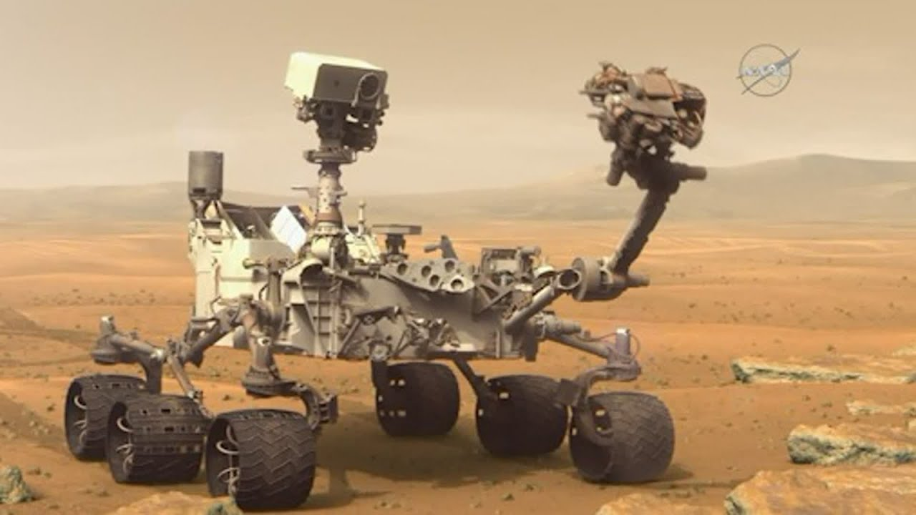
Session 1
Why ML !?
Machine learning is useful when human expertise doesn’t exist like navigation in mars.
Solutions changes in time like in communication networks base stations.
Human can’t express their expertise like blind people use speech recognition.
Grow Through

Slide 8
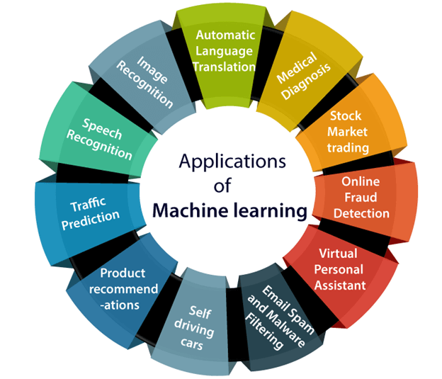
Session 1
Applications of ML
We are using machine learning in our daily life even without knowing it such as Google Maps, Google assistant, Alexa, etc.
Grow Through

Slide 9
Session 1
Subtitle
Text
Grow Through

Slide 10
Session 1
Subtitle
Text
Grow Through

Slide 11
Title
Subtitle
Text
Grow Through

